Slide 1
AI/ML based Network Device Software Upgrade in SDN Controlled Network [Work Let Id: CSW23VIT]

Slide 2
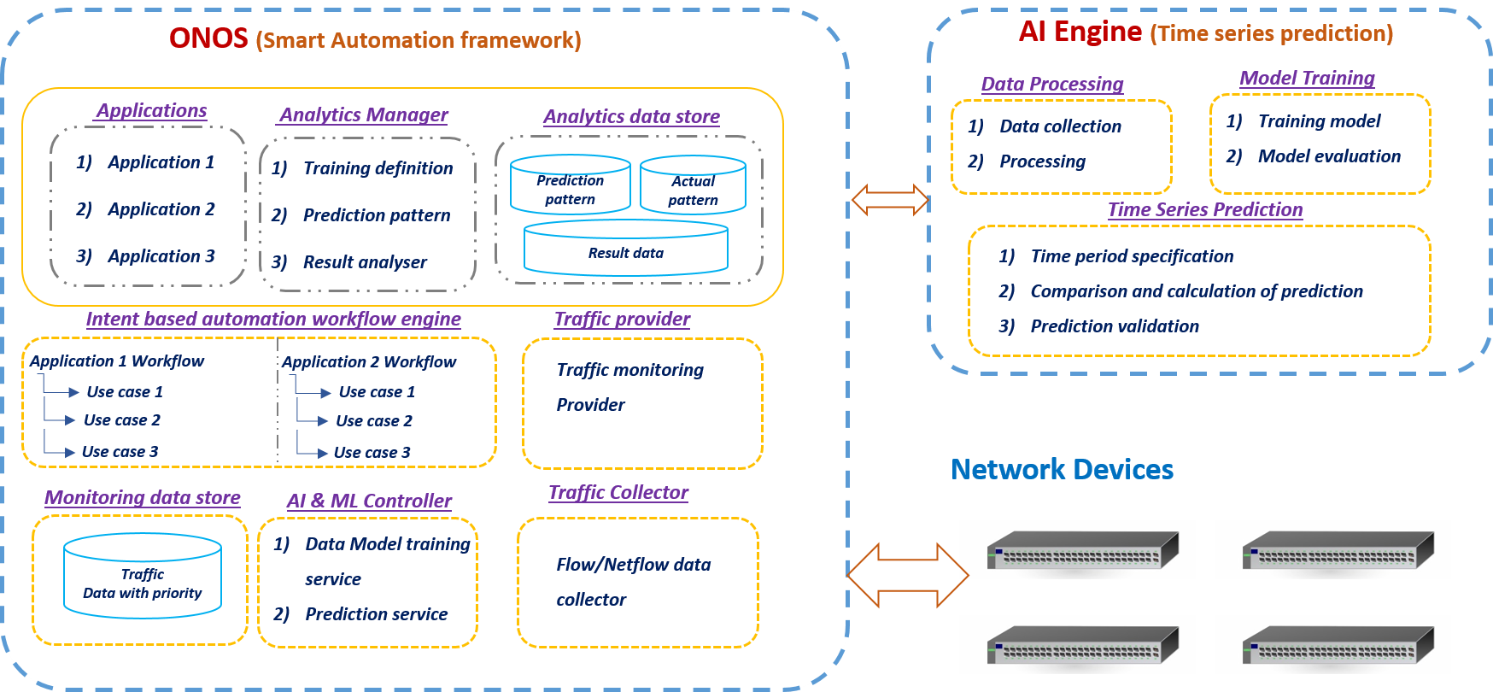
Architecture

Slide 3
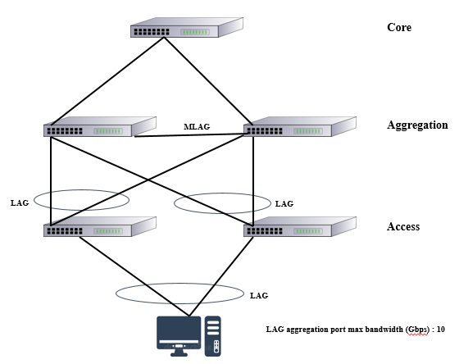
Case A - SW Upgrade during Zero or Minimal Traffic Condition
The access layer provides network connectivity to end-user devices. It also provides high availability to end user traffic whereas the aggregation layer acts as a multiplexing point between the access layer
All traffic to and from the access layer flows through the aggregation layer, the aggregation layer need to provide high availability and resiliency in the campus network. Our proposal finds zero traffic window time as manually inspecting for zero traffic would be more challenging for network operator to upgrade images.
Enterprise N/K (Access, core, etc)
Layers of topology
Use case A: Minimal traffic flow<Threshold value (user defined)

Slide 4
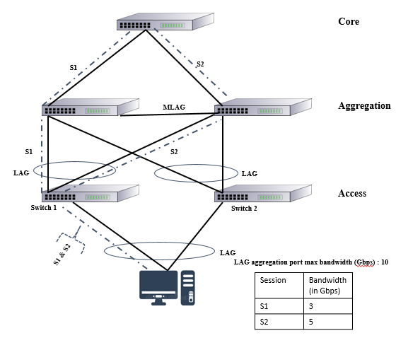
Case B - SW Upgrade with appropriate alternate traffic multi path
As multiple links connect from edge switch to distribution switches using Link Aggregation, if one switch fails, the traffic would continue to flow through the other switch. Link Aggregation can do load balancing among the various switches in the Link Aggregation Group.
The traffic sessions are split evenly between the various switches which ensures its effective utilization
Each traffic sessions would have different rate of bandwidth flow session s1 3Gbps and session s2 5Gbps bandwidth usage of different switches (total link capacity is 10Gbps each).
If operator upgrade distribution switch1(S1), eventually distribution switch1 traffic would move to distribution switch2(S2), traffic loss will be calculated as follow
Traffic rate = (S1 + S2) / bandwidth capacity of switch2
No loss = Traffic rate <= 1, Extreme traffic loss = Traffic rate > 1
Zero traffic loss if distribution switch2 have enough bandwidth to carry switch1’s traffic as figure
S1 = 3, S2 = 5, total capacity = 10
Traffic rate = (3 + 5)/10 = 0.8 = No loss
Traffic rate = (S1 + S2) / bandwidth capacity of switch2
No loss = Traffic rate <= 1, Extreme traffic loss = Traffic rate > 1
Zero traffic loss if distribution switch2 have enough bandwidth to carry switch1’s traffic
S1 = 3, s2 = 5, total capacity = 10
Traffic rate = (3 + 5)/10 = 0.8 = No loss
For switches with lag support
Checking if the traffic can be transferred to other switch

Slide 5
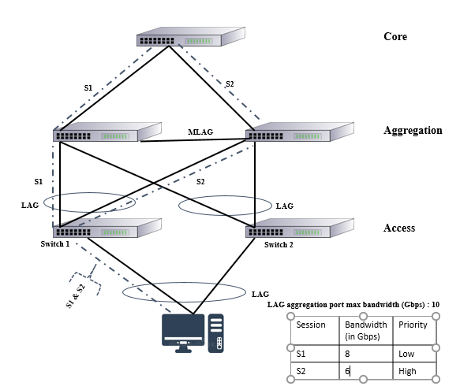
Case C - SW Upgrade with Traffic Prioritization
With Link Aggregation, each individual link can be configured to carry a separate class of traffic (like voice) if desired, using QoS parameters.
Each individual link can also be configured to carry traffic from particular node(s)/server(s).
This enables a separate un-congested route for important / latency sensitive applications/ nodes.
Some time network operator accept minimum rate of low priority traffic loss during image upgrade at peak traffic time.
Acceptance low priority traffic loss value will be given by network administrator calculate the traffic loss as follow
Tolerate traffic loss = Loss rate <= 0,
Extreme traffic loss = Loss rate > 0
Loss rate = Traffic rate – acceptance low priority traffic loss
Tolerate traffic loss if distribution switch2 have enough bandwidth to carry switch1’s low priority traffic as figure
S1 = 8, s2 = 6, total capacity = 10, acceptance low priority traffic loss = 1.5
Loss rate = ((8 + 6)/10) - 1.5 = -0.1 = Tolerate traffic loss
When one switch’s traffic can’t be transferred to the lag switch we consider ATL

Slide 6
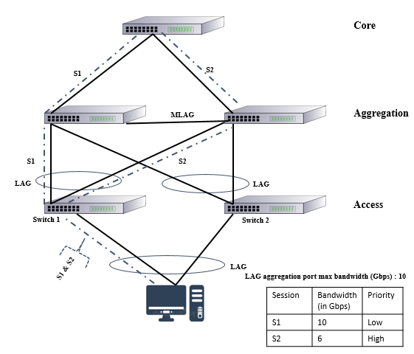
Case D - SW Upgrade with Traffic Prioritization
Huge traffic loss if distribution switch2 doesn’t have enough traffic bandwidth as figure
S1 = 10, s2 = 6, total capacity = 10, acceptance low priority traffic loss = 1.5
Loss rate = ((10 + 6)/10) - 1.5 = 0.1 = Extreme traffic loss
Network operator cannot forecast upcoming rate and priority of traffic during device upgrade down time, this will be huge negative impact in network business when provide guaranteed zero down time high priority service to the user
No lag support
Pure priority based upgradation
When the switch’s traffic is not under the threshold, nor can’t be transferred to another switch then we go for priority based s/w upgrade

Slide 7
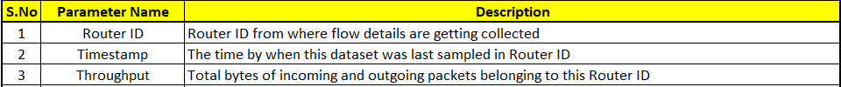
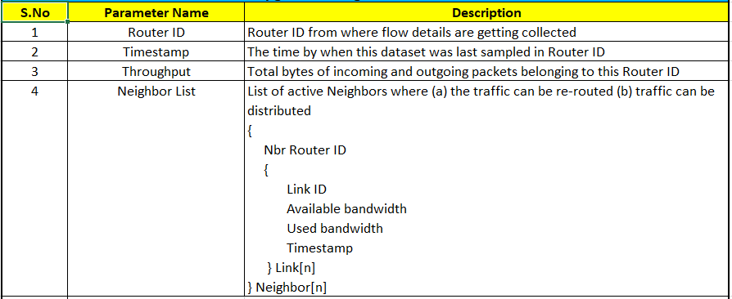
DataSet

Slide 8
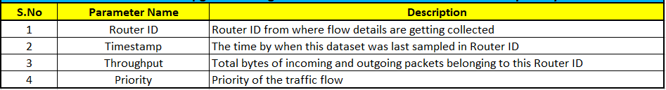
DataSet
Priority | Apps
High Priority (>=Weightage 4) | 'CITRIX', 'CLOUDFLARE', 'CONTENT_FLASH', 'DNS', 'DROPBOX','HTTP', 'HTTP_CONNECT', 'HTTP_DOWNLOAD', 'HTTP_PROXY', 'IP_ICMP', 'MAIL_IMAPS', 'MICROSOFT', 'MQTT', 'MSN', 'MSSQL', 'MS_ONE_DRIVE', 'NTP', 'OFFICE_365', 'OPENSIGNAL', 'SKYPE', 'SSL', 'SSL_NO_CERT', 'TEAMVIEWER', 'TOR'
Low Priority(< Weightage 4) | 'AMAZON', 'APPLE', 'APPLE_ICLOUD', 'APPLE_ITUNES', 'EASYTAXI', 'EBAY', 'FACEBOOK', 'FTP_DATA', 'GMAIL', 'GOOGLE', 'GOOGLE_MAPS', 'INSTAGRAM', 'SPOTIFY', 'TWITTER', 'UBUNTUONE', 'WHATSAPP', 'WIKIPEDIA', 'WINDOWS_UPDATE', 'YAHOO', 'YOUTUBE'

Slide 9
Experimental Results

Slide 10
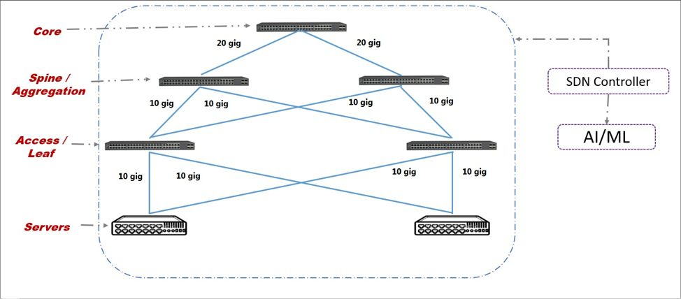
Topology considered
Draw devices(with capacity) considered in each level
S1
S2
S3
S4
S5

Slide 11
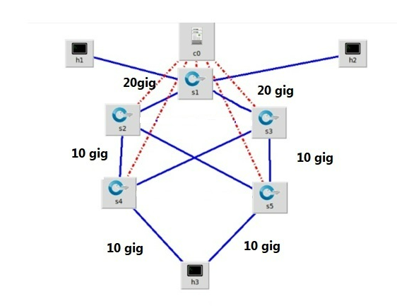
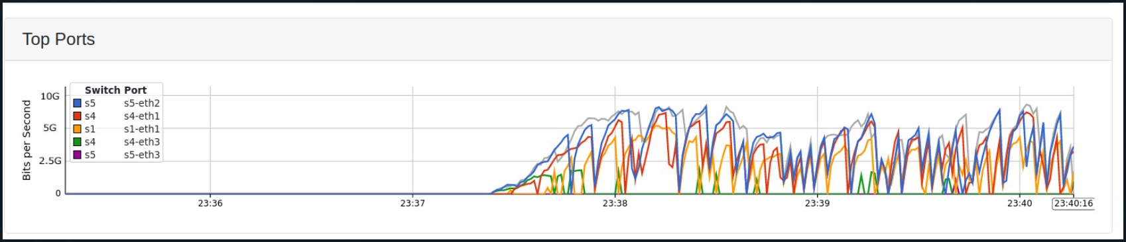
DataSet Generation
Mininet Demo (Sflow)
Controllers explored till now =>
Default controller: Open Flow controller
ROU controller
Flood light controller
Open Daylight controller
What controller being used now =>
Mininet Topology
Sflow:-

Slide 12
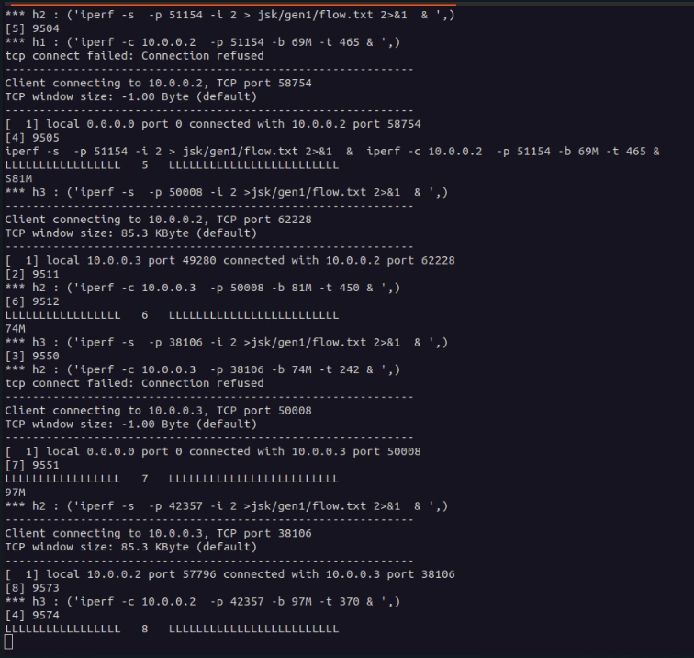
DataSet Generation
Sflow
A sample where the code automates the SFlow and data generation simultaneously

Slide 13
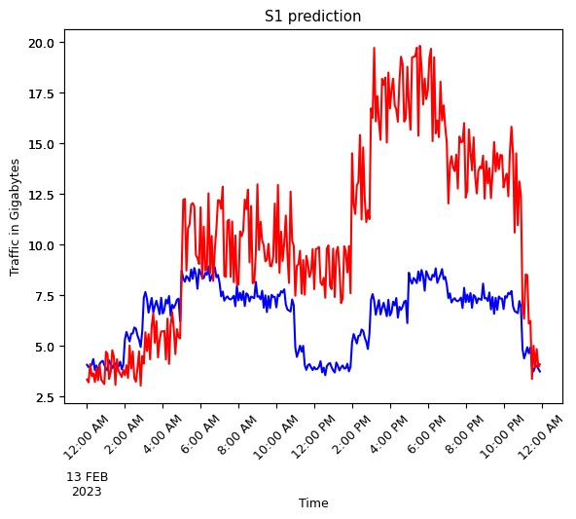
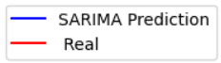
SARIMA Model Results
Now VS CODE demo
SWITCH1

Slide 14
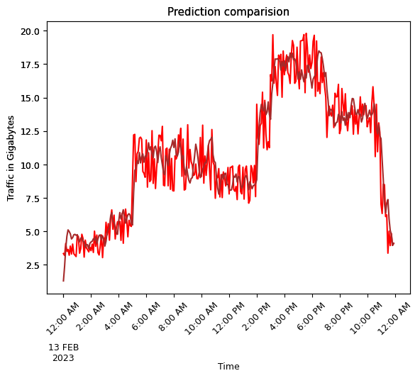
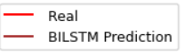
Bi LSTM Model Results
SWITCH 1

Slide 15
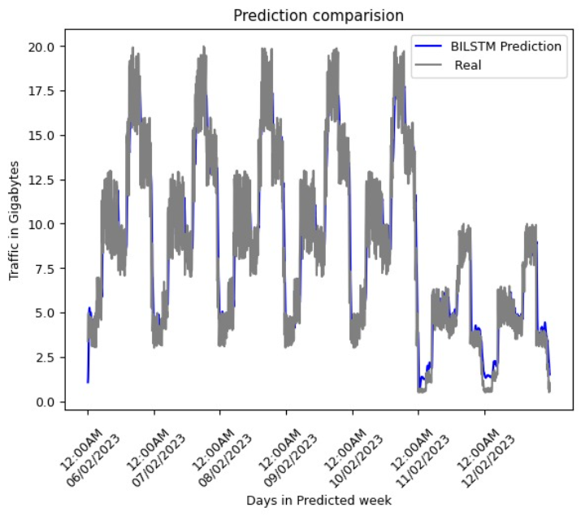
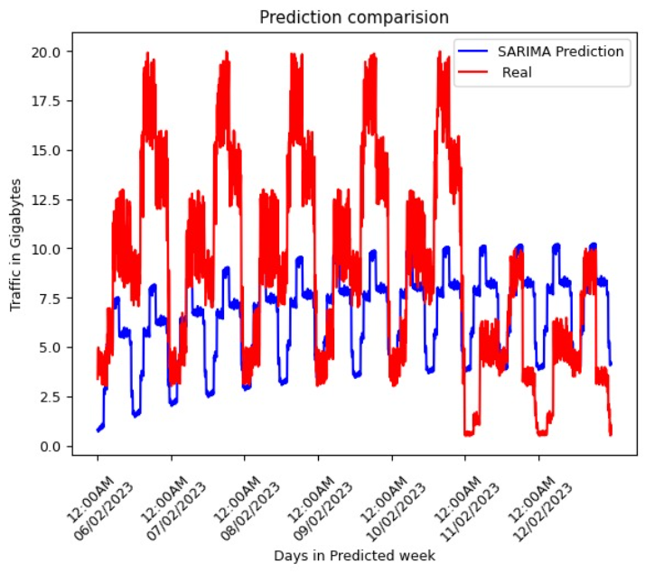
SARIMA Vs Bi LSTM – Results comparison
BiLSTM VS Real
SARIMA VS Real

Slide 16
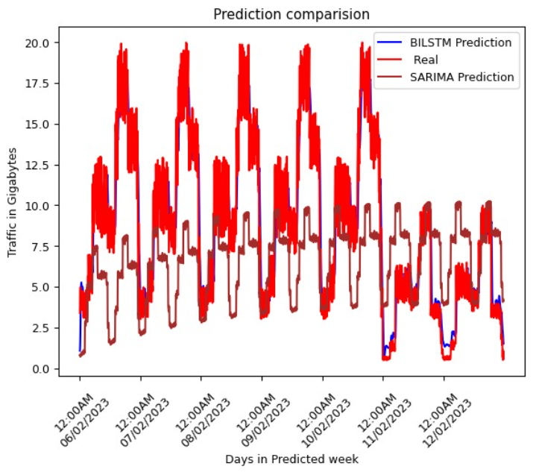
SARIMA Vs Bi LSTM – Results comparison
Prediction Comparison Using SARIMA And Bilstm Models, With The Actual Dataset.
MODeL | MSE (mean square error) | MAE (mean absolute error)
BI-LSTM | 0.0771 | 0.056
SARIMA | 3.61 | 4.54
BiLSTM was found to give better accuracy for the considered system, than SARIMA model.

Slide 17
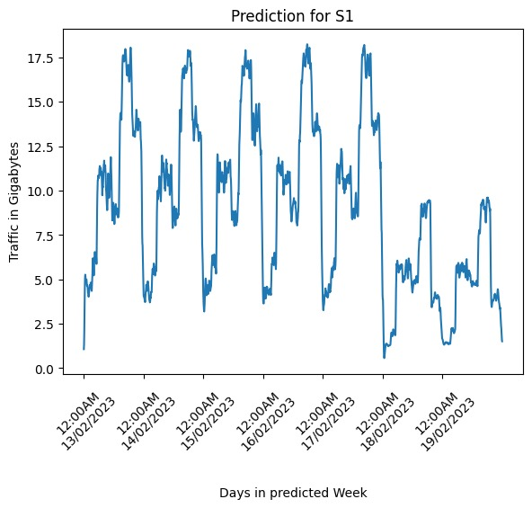
Traffic Prediction for all devices in Topology
SWITCH 1

Slide 18
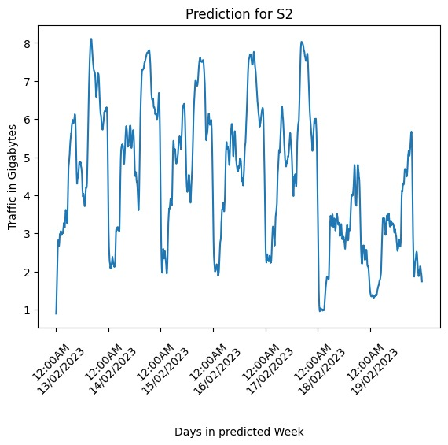
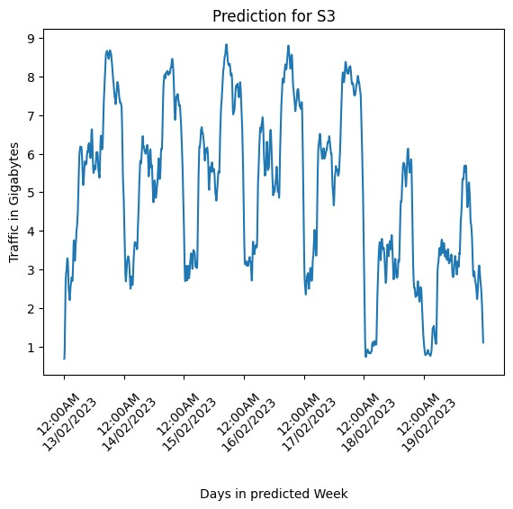
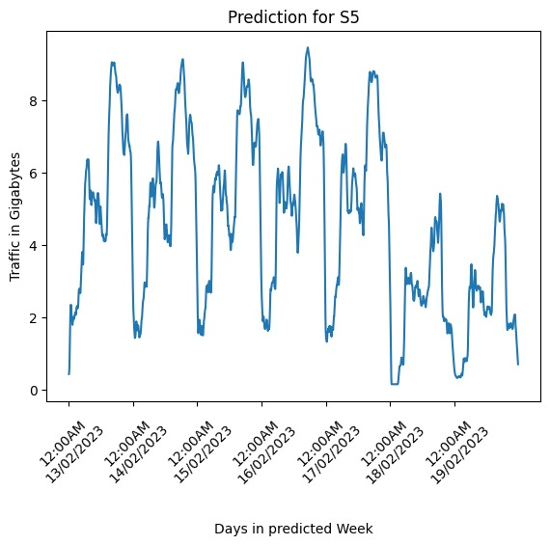

Traffic Prediction for all devices in Topology
SWITCH2
SWITCH3
SWITCH4
SWITCH5

Slide 19
Algorithm Used
SET TRAFFIC THRESHOLD T_th SET PRIORITY THRESHOLD P_th SET LOW PRIORITY TRAFFIC THRESHOLD LT_th SET ACCEPTABLE TRAFFIC LOSS ATL
procedure EXECUTENOSUPDATE(Sn) if Find_leanperiod (Sn)) == 1 then update NOS elseif LAG supported (Sn) == true then [active/stand-by - Sm] if (Traffic(Sn)+Traffic(Sm))< MB_Sm then update NOS elseif (PL_Sn < P_th) && ((Traffic(Sn)+Traffic(Sm))< (MB_Sm -ATL)) then update NOS end if end if else if ((PL_Sn < P_th) && (Traffic(Sn) < ATL)) then update NOS end if end procedure =======================
MB_Sm - Maximum bandwidth of switch Sm Priority level of Switch - PL_S Traffic of switch - T_S

Slide 20
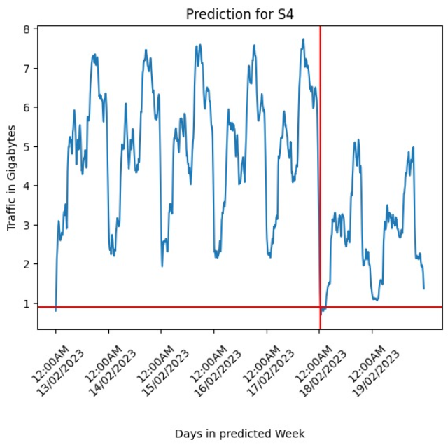
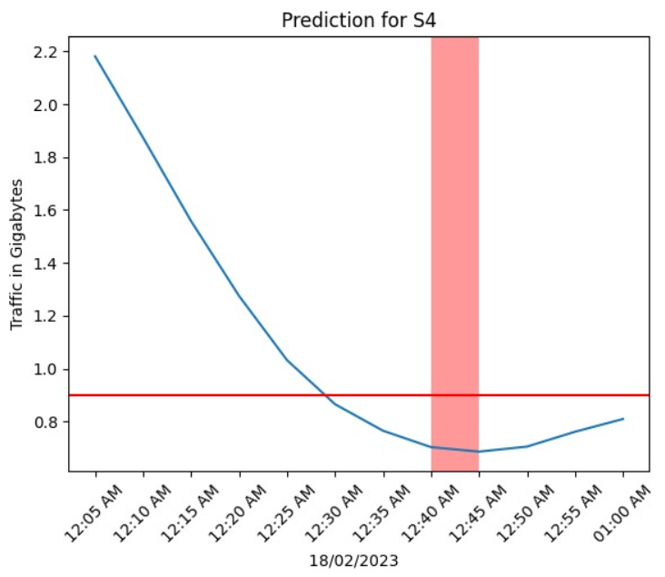
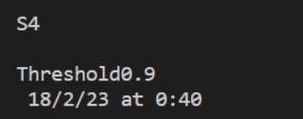
[Use case A]:NOS UPGRADE TIME PREDICTION- SWITCH 4

Slide 21
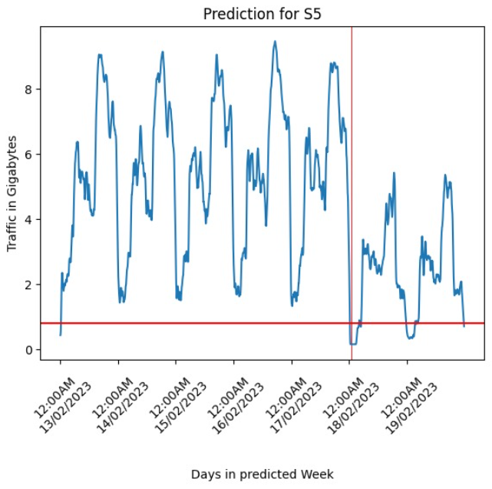
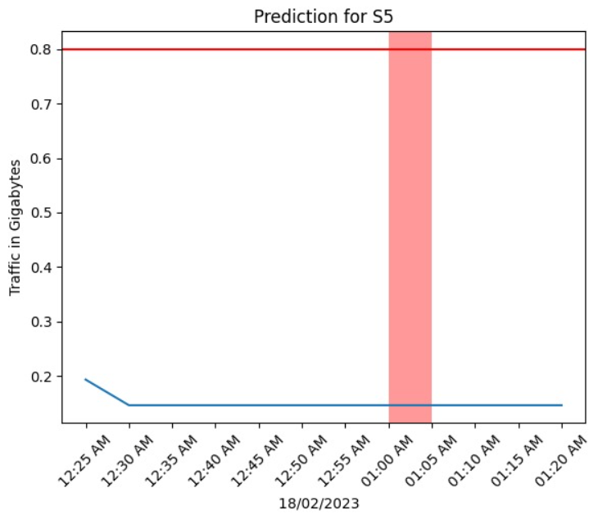
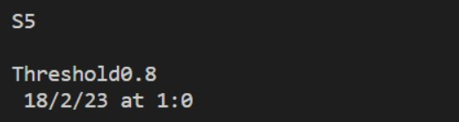
[Use case A]: NOS UPGRADE TIME PREDICTION- SWITCH 5

Slide 22
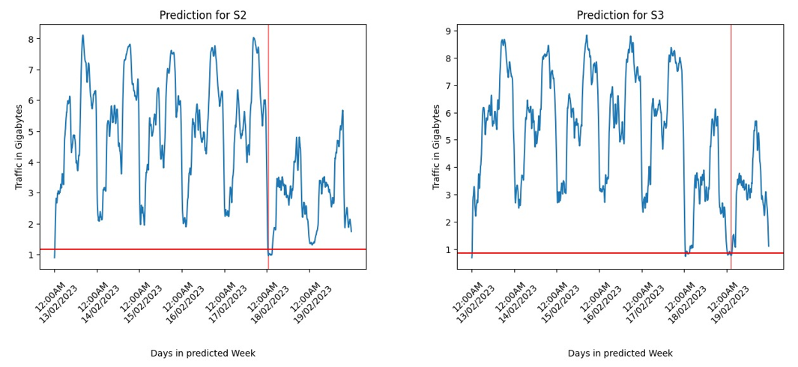
[Use case B]: NOS UPGRADE TIME PREDICTION- SWITCH 2 &3

Slide 23
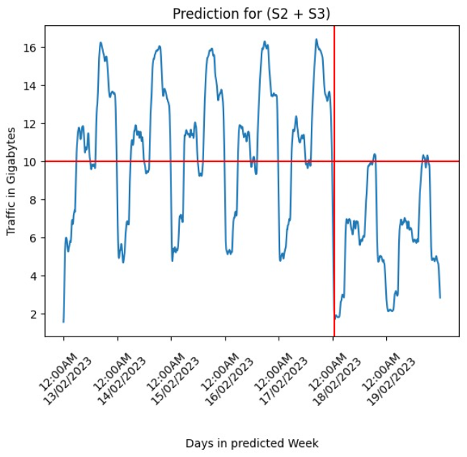
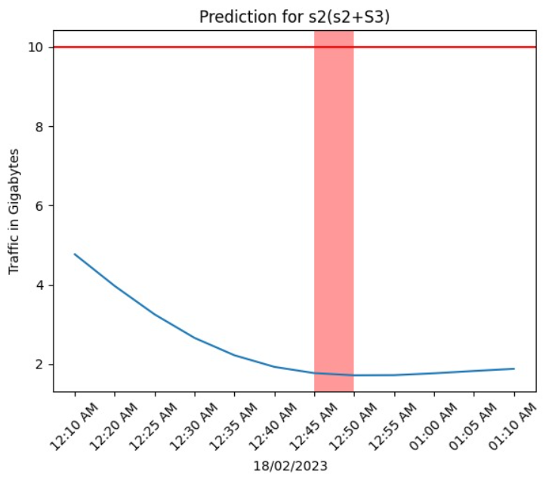
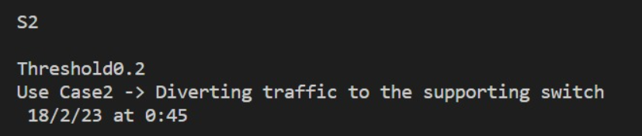
[Use case B]: NOS UPGRADE TIME PREDICTION- SWITCH 2 &3
Switch Capacity

Slide 24
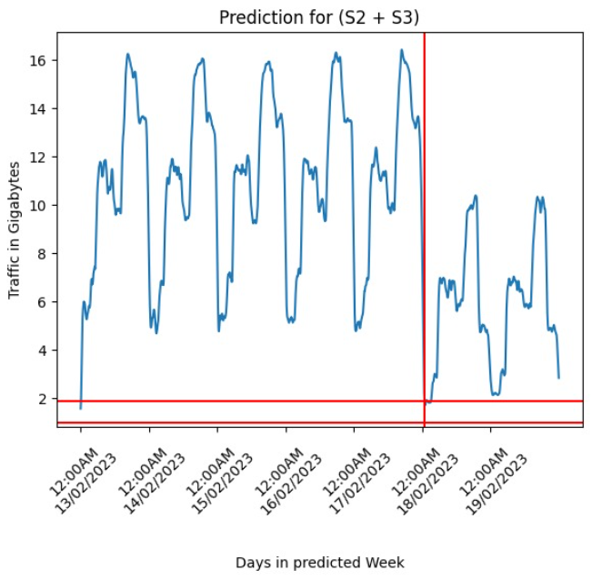
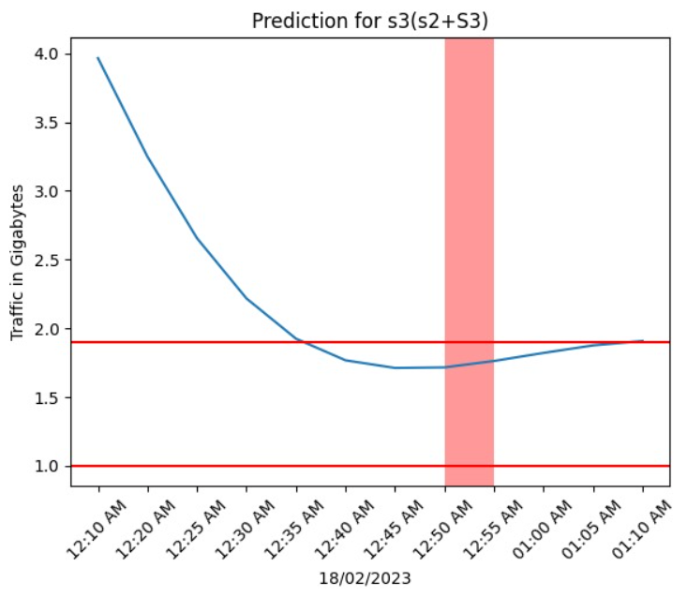
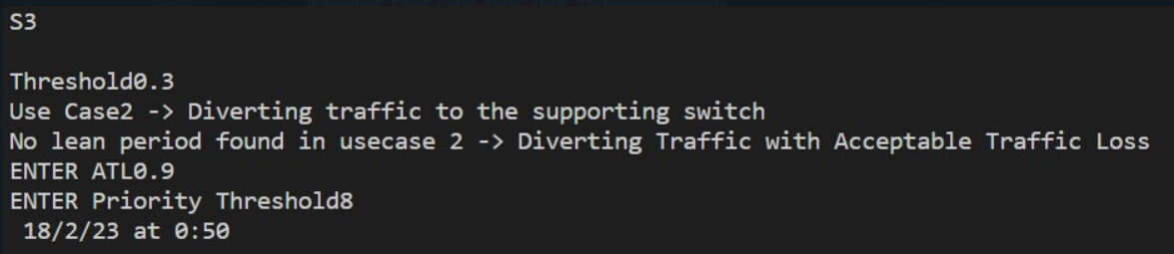
[Use case C]: NOS UPGRADE TIME PREDICTION- SWITCH 2 &3
ATL
Switch Capacity

Slide 25
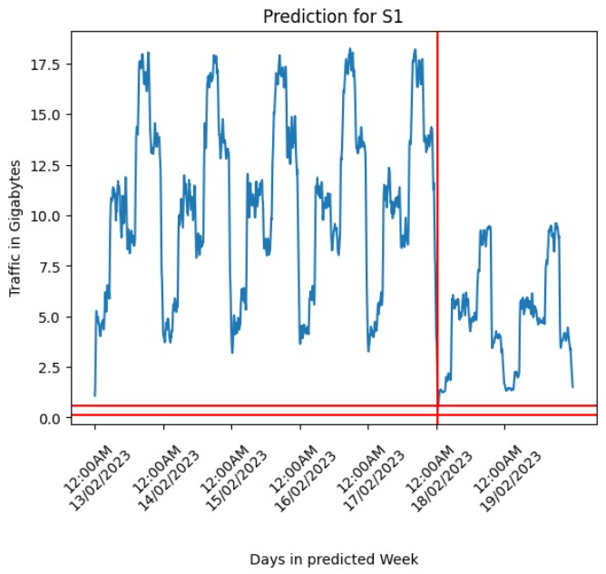
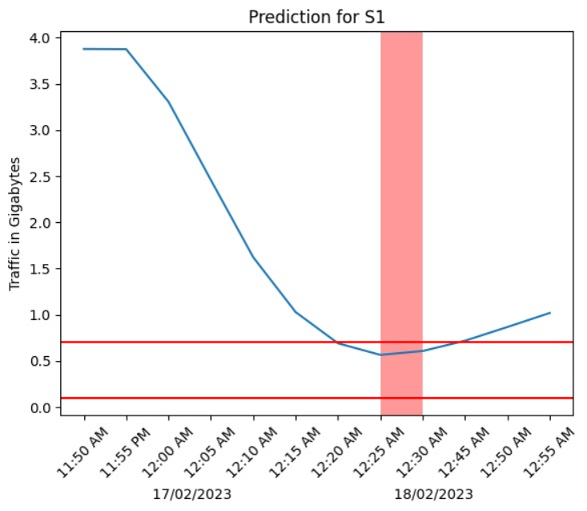
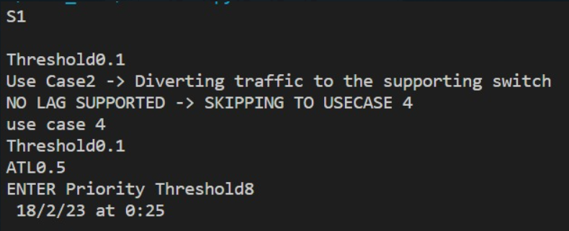
[Use case D]: NOS UPGRADE TIME PREDICTION- SWITCH1
ATL

Slide 26
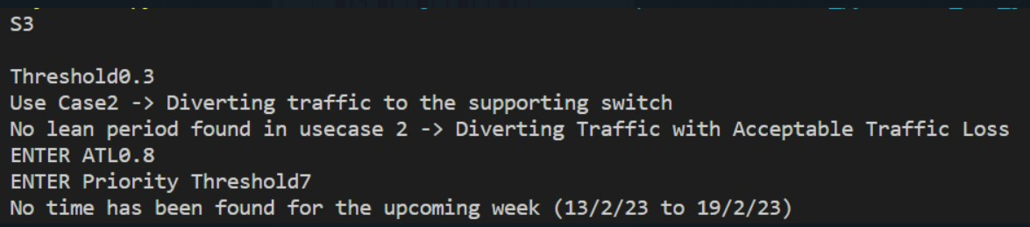
Use case E : Result [When no suitable time is found]

Slide 27
Result Table: Device Vs NOS suitable time
SWITCH | TIME
S1 | 18/02/2023 @ 00:25 HOURS
S2 | 18/02/2023 @ 00:45 HOURS
S3 | 18/02/2023 @ 00:50 HOURS
S4 | 18/02/2023 @ 00:40 HOURS
S5 | 18/02/2023 @ 01:00 HOURS

